Slide 1
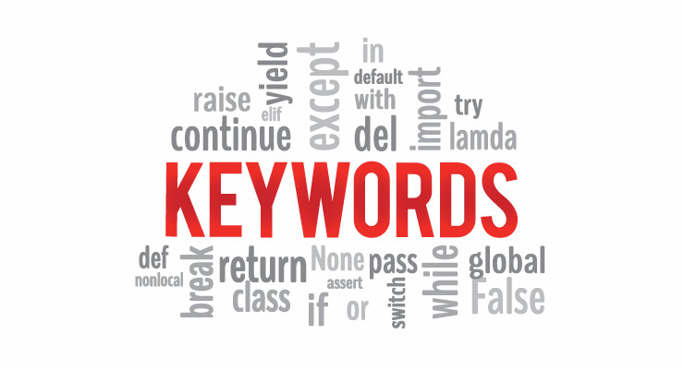
Python Keywords and Identifiers

Slide 2
Keywords
Keywords in Python programming language
False | class | finally | is | return
None | continue | for | lambda | try
True | def | from | nonlocal | while
and | del | global | not | with
as | elif | if | or | yield
assert | else | import | pass
break | except | in | raise

Slide 3
Python Keywords
Keywords are the reserved words in Python.
We cannot use a keyword as variable name, function name or any other identifier. They are used to define the syntax and structure of the Python language.
In Python, keywords are case sensitive.
Python Keywords may get altered in different versions of Python. Some extra might get added or some might be removed.
We can always get the list of keywords in our current version by typing the following commands in the prompt.
>>> import keyword
>>> print(keyword.kwlist)

Slide 4
Description of Keywords in Python with examples
True, False
True and False are truth values in Python. They are the results of comparison operations or logical (Boolean) operations in Python.
Ex: >>> 1 == 1 ( True)
>>> 5 > 3 (True)
>>> True or False (True)
>>> 10 <= 1 (False)
>>> 3 > 7 (False)
>>> True and False (False)

Slide 5
True and False in python is same as 1and 0. This can be justified with the following example:
>>> True == 1 True
>>> False == 0 True
>>> True + True 2
None
None is a special constant in Python that represents the absence of a value or a null value.
It is an object of its own datatype, the NoneType. We cannot create multiple None objects but can assign it to variables. These variables will be equal to one another.
We must take special care that None does not imply False, 0 or any empty list, dictionary, string etc. For example:

Slide 6
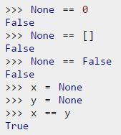

Slide 7
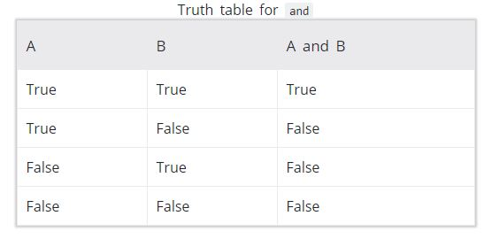
and, or , not :
and, or, not are the logical operators in Python. and will result into True only if both the operands are True. The truth table for and is given below:

Slide 8
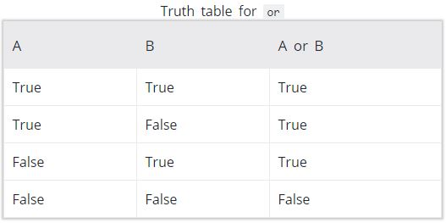
or will result into True if any of the operands is True. The truth table for or is given below:

Slide 9
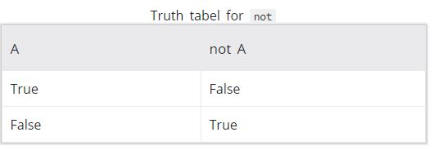
not operator is used to invert the truth value. The truth table for not is given below:
>>> True and False
False
>>> True or False
True
>>> not False
True

Slide 10
as: as is used to create an alias while importing a module. It means giving a different name (user-defined) to a module while importing it.
as for example, Python has a standard module called math. Suppose we want to calculate what cosine pi is using an alias. We can do it as follows using as:
>>> import math as myAlias
>>>myAlias.cos(myAlias.pi)
Here we imported the math module by giving it the name myAlias. Now we can refer to the math module with this name. Using this name we calculated cos(pi) and got -1.0 as the answer.

Slide 11
assert: assert is used for debugging purposes.
While programming, sometimes we wish to know the internal state or check if our assumptions are true. assert helps us do this and find bugs more conveniently. assert is followed by a condition.
If the condition is true, nothing happens. But if the condition is false, AssertionError is raised.
>>> a = 4
>>> assert a < 5
>>> assert a > 5
AssertionError
For our better understanding, we can also provide a message to be printed with the AssertionError.
>>> a = 4
>>> assert a > 5, "The value of a is too small"

Slide 12
break, continue:break and continue are used inside for and while loops to alter their normal behavior.
break will end the smallest loop it is in and control flows to the statement immediately below the loop. continue causes to end the current iteration of the loop, but not the whole loop.
class:class is used to define a new user-defined class in Python.
Class is a collection of related attributes and methods that try to represent a real world situation. This idea of putting data and functions together in a class is central to the concept of object-oriented programming (OOP).
def:def is used to define a user-defined function.
Function is a block of related statements, which together does some specific task. It helps us organize code into manageable chunks and also to do some repetitive task.

Slide 13
The usage of def is shown below:
def function_name(parameters):
del: del is used to delete the reference to an object. Everything is object in Python. We can delete a variable reference using del
>>> a = b = 5
>>> del a
>>> a
NameError: name 'a' is not defined
>>> b o/p:5
del is also used to delete items from a list or a dictionary
>>> a = ['x','y','z']
>>> del a[1]
>>> a o/p:['x', 'z']

Slide 14
if, else, elif:if, else, elif are used for conditional branching or decision making.
except, raise, try:except, raise, try are used with exceptions in Python.
Exceptions are basically errors that suggests something went wrong while executing our program. IOError, ValueError, ZeroDivisionError, ImportError, NameError, TypeError etc. are few examples of exception in Python. try...except blocks are used to catch exceptions in Python.
finally:finally is used with try…except block to close up resources or file streams.
for:for is used for looping. Generally we use for when we know the number of times we want to loop.

Slide 15
from, import:import keyword is used to import modules into the current namespace. from…import is used to import specific attributes or functions into the current namespace.
Ex:import math
It will import the math module. Now we can use the cos() function inside it as math.cos(). But if we wanted to import just the cos() function, this can done using from as
>>> from math import cos
now we can use the function simply as cos(), no need to write math.cos().
global: global is used to declare that a variable inside the function is global ( outside the function).
If we need to read the value of a global variable, it is not necessary to define it as global. This is understood.

Slide 16
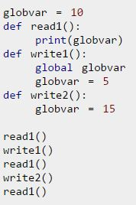
If we need to modify the value of a global variable inside a function, then we must declare it with global. Otherwise a local variable with that name is created.
Ex:

Slide 17
Here, the read1() function is just reading the value of globvar. So, we do not need to declare it as global. But the write1() function is modifying the value, so we need to declare the variable as global.
We can see in our output that the modification did take place (10 is changed to 5). The write2() also tries to modify this value. But we have not declared it as global.
Hence, a new local variable globvar is created which is not visible outside this function. Although we modify this local variable to 15, the global variable remains unchanged. This is clearly visible in our output.
in: in is used to test if a sequence (list, tuple, string etc.) contains a value. It returns True if the value is present, else it returns False.

Slide 18
For example: >>> a = [1, 2, 3, 4, 5]
>>> 5 in a
True
>>> 10 in a
False
The secondary use of in is to traverse through a sequence in a for loop.
>>>for i in 'hello':
print(i)
is: is is used in Python for testing object identity. While the == operator is used to test if two variables are equal or not, 'is' is used to test if the two variables refer to the same object.
It returns True if the objects are identical and False if not.

Slide 19
>>> True is True
True
>>> False is False
True
>>> None is None
True
We know that there is only one instance of True, False and None in Python, so they are identical.
>>> [] == []
True
>>> [] is []
False
>>> {} == {}
True
>>> {} is {}
False

Slide 20
An empty list or dictionary is equal to another empty one. But they are not identical objects as they are located separately in memory. This is because list and dictionary are mutable (value can be changed).
>>> ‘ ‘ == ‘ ‘
True
>>> ‘ ‘ is ‘ ‘
True
>>> () == ()
True
>>> () is ()
True

Slide 21
Unlike list and dictionary, string and tuple are immutable (value cannot be altered once defined). Hence, two equal string or tuple are identical as well. They refer to the same memory location.
lambda: lambda is used to create an anonymous function (function with no name). It is an inline function that does not contain a return statement. It consists of an expression that is evaluated and returned.
For example: a = lambda x: x**2
for i in range(1,6):
print(a(i))
Here, we have created an inline function that doubles the value, using the lambda statement. We used this to double the values in a list containing 1 to 5.

Slide 22
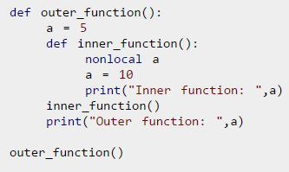
nonlocal:The use of nonlocal keyword is very much similar to the global keyword. nonlocal is used to declare that a variable inside a nested function (function inside a function) is not local to it, meaning it lies in the outer inclosing function. If we need to modify the value of a non-local variable inside a nested function, then we must declare it with nonlocal. Otherwise a local variable with that name is created inside the nested function.

Slide 23
pass:pass is a null statement in Python. Nothing happens when it is executed. It is used as a placeholder.
Suppose we have a function that is not implemented yet, but we want to implement it in the future. Simply writing,
def function(args):
in the middle of a program will give us IndentationError. Instead of this, we construct a blank body with the pass statement.
def function(args):
pass
We can do the same thing in an empty class as well.
class example:
pass
return:return statement is used inside a function to exit it and return a value.

Slide 24
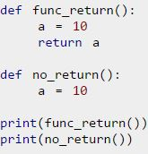
if we do not return a value explicitly, None is returned automatically. This is verified with the following example.

Slide 25
while: while is used for looping in python.
with: with statement is used to wrap the execution of a block of code within methods defined by the context manager.
Context manager is a class that implements _enter_ and _exit_ methods. Use of with statement ensures that the _exit_ method is called at the end of the nested block. This concept is similar to the use of try….finally block.
Ex: with open(‘example.txt’, ’w’) as my _file
my_file.write(‘Hello world”)
This example writes the text hello world to the file example.txt. File objects have __enter__ and __exit__ method defined within them, so they act as their own context
manager.

Slide 26
First the __enter__ method is called, then the code within with statement is executed and finally the __exit__ method is called. __exit__ method is called even if there is an error. It basically closes the file stream.
yield: yield is used inside a function like a returns statement. But yield return a generator.
Generator is an iterator that generates one item at a time. A large list of value will take up a lot of memory. Generators are useful in this situation as it generates only one value at a time instead of storing all the values in memory.
>>> g = (2**x for x in range(100))
will create a generator g which generates powers of 2 up to the number two raised to the power 99. We can generate the numbers using the next() function as shown below.

Slide 27
>>> next(g)
1
>>> next(g)
2
>>> next(g)
4
>>> next(g)
8
>>> next(g)
16
And also This type of generator is returned by the yield statement from a function.
Here is an example.

Slide 28
def generator():
    for i in range(6):
      yield i*i
g = generator()
for i in g:
print(i)

Slide 29
Python Identifiers
Identi?er is the name given to entities like class, functions, variables etc. in Python. It helps differentiating one entity from another.
Rules for writing identifiers:
Identifiers can be a combination of letters in lowercase (a to z) or uppercase (A to Z) or digits (0 to 9) or an underscore (_). Names like myClass , var_1 and print_this_to_screen , all are valid example.
An identifier cannot start with a digit. 1variable is invalid, but variable1 is perfectly fine.
Keywords cannot be used as identifiers.

Slide 30
>>> global = 1
We cannot use special symbols like !, @, #, $, % etc. in our identifiers.
>>> a@ = 0
Identifier can be of any length.
Additional information
Python is a case-sensitive language. This means, Variable and variable are not the same. Always name identifiers that make sense.
Multiple words can be separated using an underscore, this_is_a_long_variable .
We can also use camel-case style of writing, i.e., capitalize every first letter of the word except the initial word without any spaces. For example: camelCaseExample.

Slide 31
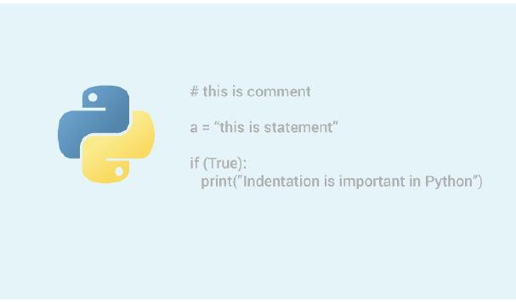
Python Statement, Indentation and
Comments
we will learn about Python statements, why indentation is important and use of comments in programming.

Slide 32
Python Statement
Multi-line statement: In Python, end of a statement is marked by a newline character. But we can make a statement extend over multiple lines with the line continuation character (\).
For example: a = 1 + 2 + 3 + \
4 + 5 + 6 + \
7 + 8 + 9
This is explicit line continuation. In Python, line continuation is implied inside parentheses ( ), brackets [ ] and braces { }. For instance, we can implement the above multi-line statement as
a = (1 + 2 + 3 +
4 + 5 + 6 +
7 + 8 + 9)

Slide 33
Here, the surrounding parentheses ( ) do the line continuation implicitly. Same is the case with [ ] and { }. For example:
colors = ['red',
'blue',
'green']
We could also put multiple statements in a single line using semicolons, as follows Ex:a = 1; b = 2; c = 3

Slide 34
Python Indentation
Most of the programming languages like C, C++, Java use braces { } to define a block of code. Python uses indentation.
A code block (body of a function, loop etc.) starts with indentation and ends with the first unindented line. The amount of indentation is up to you, but it must be consistent throughout that block.
for i in range(1,11):
print(i)
If i == 5:
break
The enforcement of indentation in Python makes the code look neat and clean. This results into Python programs that look similar and consistent.

Slide 35
Indentation can be ignored in line continuation. But it's a good idea to always indent. It makes the code more readable.
For example:
if True:
print('Hello')
a = 5
if True: print('Hello'); a = 5
Incorrect indentation will result into IndentationError .

Slide 36
Python Comments
Comments are very important while writing a program. It describes what's going on inside a program so that a person looking at the source code does not have a hard time figuring it out. You might forget the key details of the program you just wrote in a month's time. So taking time to explain these concepts in form of comments is always fruitful.
In Python, we use the hash (#) symbol to start writing a comment.
It extends up to the newline character. Comments are for programmers for better understanding of a program. Python Interpreter ignores comment.

Slide 37
#This is a comment
#print out Hello
print('Hello')
Multi-line comments
If we have comments that extend multiple lines, one way of doing it is to use hash (#) in the beginning of each line.
For example:#This is a long comment
#and it extends
#to multiple lines
Another way of doing this is to use triple quotes, either ''' or ""“
These triple quotes are generally used for multi-line strings. But they can be used as multi-line comment as well. Unless they are not docstrings, they do not generate any extra code.

Slide 38
"""This is also a
perfect example of
multi-line comments""“
Docstring in Python:
Docstring is short for documentation string.
It is a string that occurs as the first statement in a module,funtion,class,or method definition. We must write what a function/class does in the docstring.
Triple quotes are used while writing docstrings. For example:
def double(num):
"""Function to double the
value"""
return 2*num

Slide 39
Docstring is available to us as the attribute __doc__ of the function. Issue the following code in shell once you run the above program.
>>> print(double.__doc__)
Function to double the value

